Slide 1


eTaya // a blockchain-enabled lottery mobile app Presented by: Team lucid
// Jomar Bernedo
// Angela luz
// Aaron magcayang

Slide 2

eTaya // a blockchain-enabled lottery mobile app Presented by: Team lucid
// Jomar Bernedo
// Angela luz
// Aaron magcayang
2

Slide 3

What is eTaya?
Blockchain-enabled mobile lottery app
Caveat: prototype version
Focuses on 6/42 Lotto
Next stage: Incorporation of other lottery games; betting/payouts done via blockchain (fully trustless/anonymous)
3

Slide 4






SECURITY
di mahahack!
CONVENIENCE
yes, di na pipila!
IMMUTABILITY
di madadaya!
Why eTaya?
// Why should people use it?
// Why should PCSO adopt it?
MINIMIZE TICKET LOSS
diretso bakasyon!
CASHLESS
i-UB Online na!
WIDER MARKET REACH
mas maraming matutulungan ang PCSO!
4

Slide 5
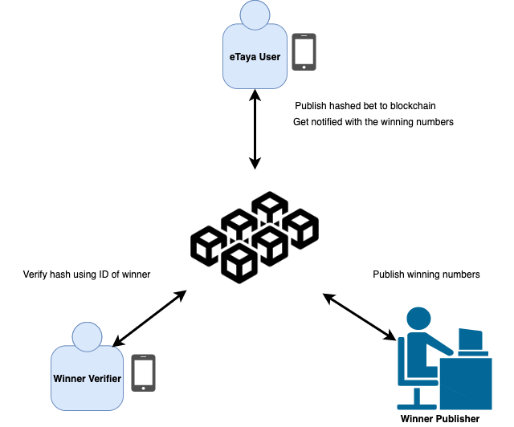
eTaya System Overview:
High-level flow of information

Slide 6
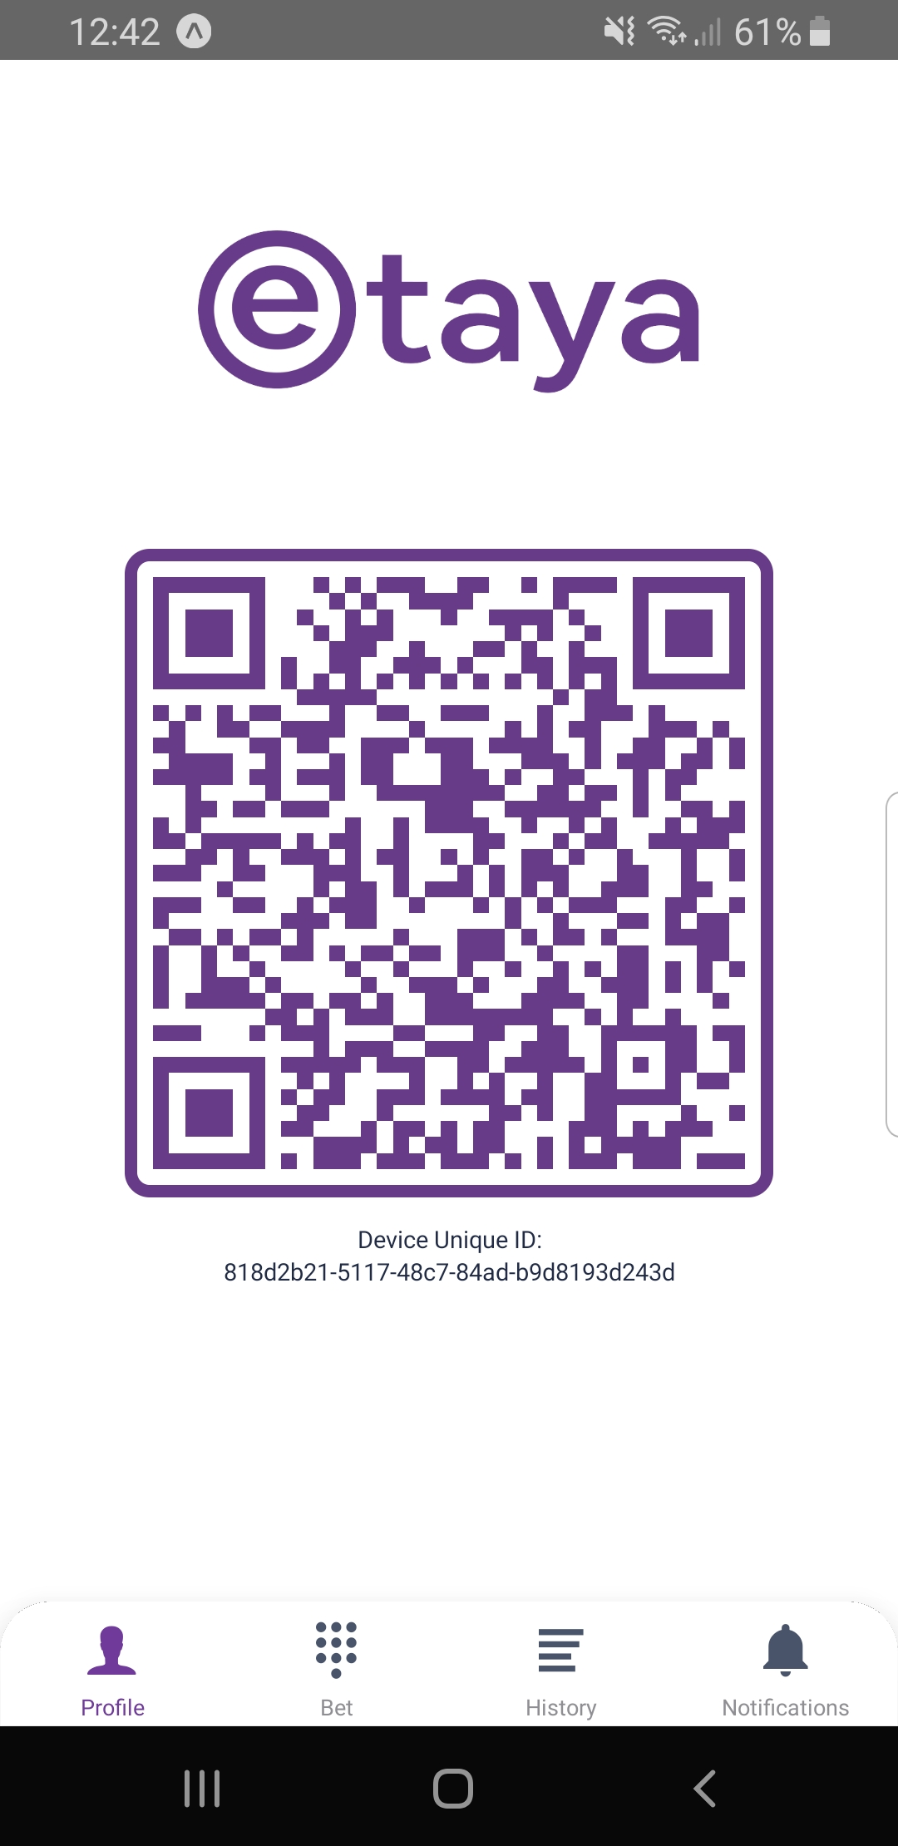
Note: The personas presented are fictional. Any resemblance to actual persons or events is purely coincidental..
Use Cases for eTaya

Slide 7
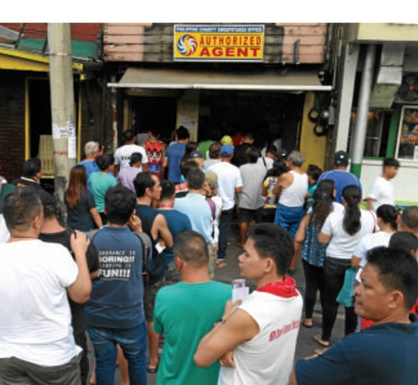
Use Case # 1: Pablo
This is Pablo.
Lagi siyang late dumadating sa office.
Dami niyang palusot kay boss, pero sa totoo lang tumataya kasi siya sa lotto every week bago pumasok.
7
Src: https://newsinfo.inquirer.net/1041213/7-things-you-should-know-about-the-lotto

Slide 8

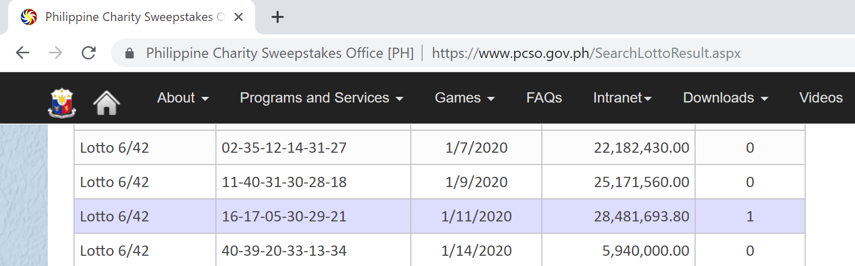
Use Case # 2: Susan
This is Susan.
Sobrang busy niya, hindi niya alam naka-jackpot pala siya sa lotto!
On the last day of claiming, naalala niyang i-check, but oh no, nawawala na yung ticket niya! ☹
Sayang, she could’ve used the money to expand her business.
8
Src: https://ph.theasianparent.com/10-home-based-jobs, https://www.pcso.gov.ph/SearchLottoResult.aspx

Slide 9

Use Case # 3: Sir Joey
This is Sir Joey, a Board Member of PCSO.
He’s dismayed at the state of healthcare services in the Philippines.
He would like to increase PCSO revenues primarily to support more Filipinos availing of the Individual Medical Assistance Program (528,190m patients served in 2018).
He’s open to new and innovative ideas for the benefit of the Filipino people.
9
Src: https://www.philstar.com/headlines/2019/07/29/1938904/where-do-pcso-revenues-go

Slide 10

eTaya App Walkthrough:
Landing Page

Slide 11

eTaya App Walkthrough:
Profile Page

Slide 12
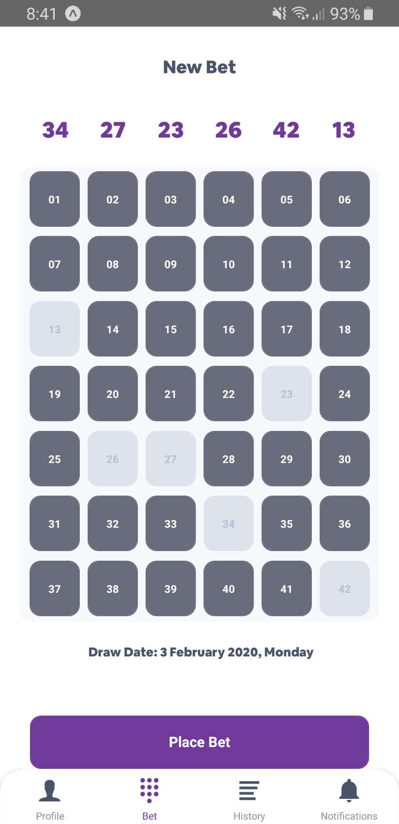
eTaya App Walkthrough:
Place New Bet

Slide 13
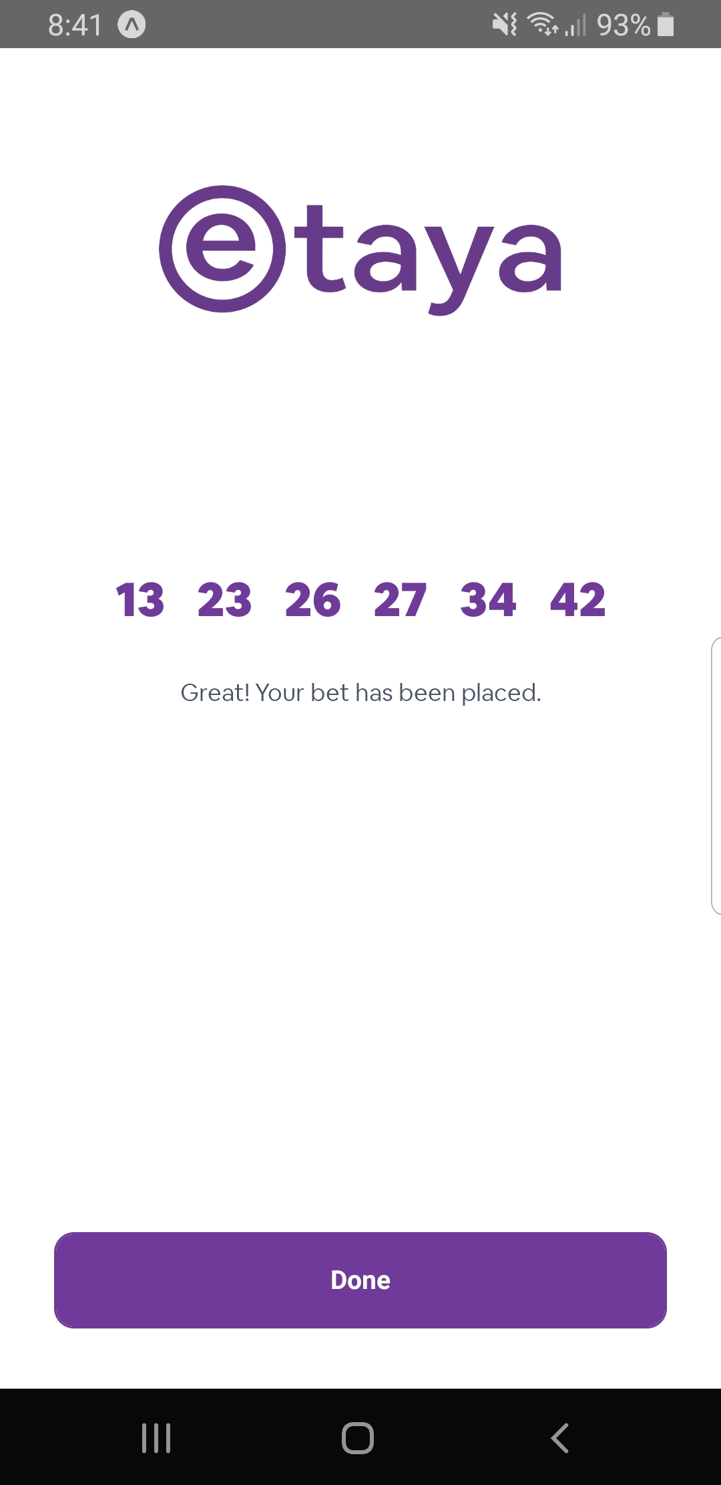
eTaya App Walkthrough:
Confirmation Page
Great! Your bet has been placed.
Payment ref. number: K624AVMVG5YYS

Slide 14
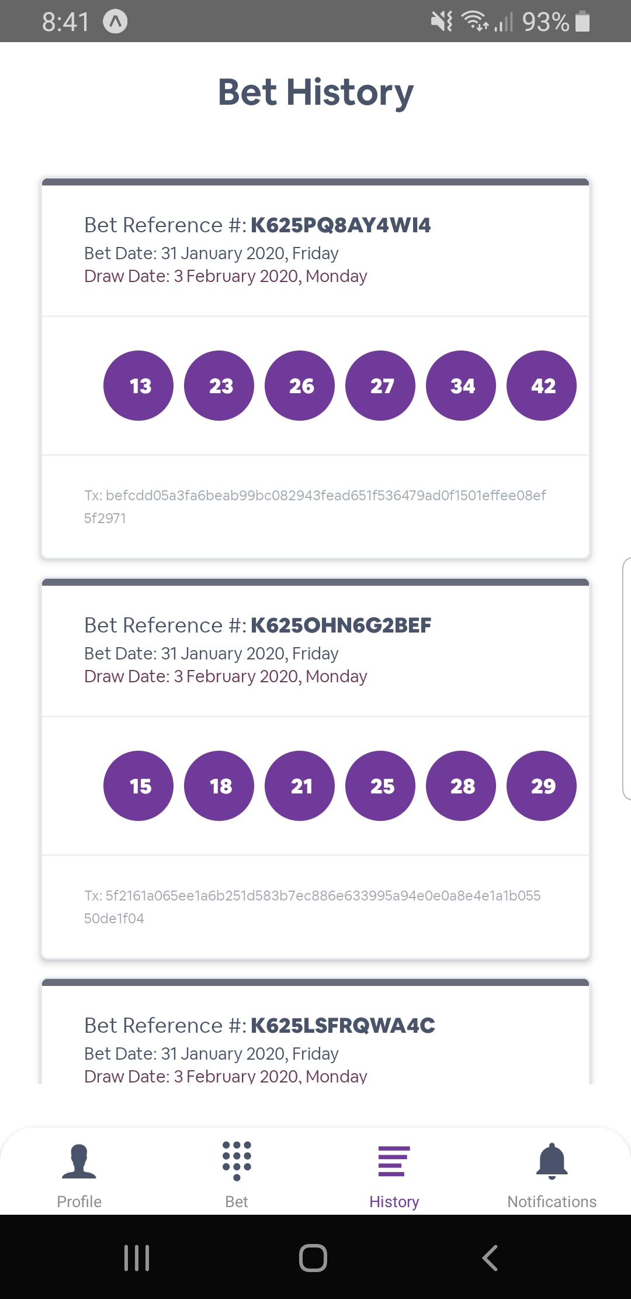
eTaya App Walkthrough:
Historical Bets

Slide 15
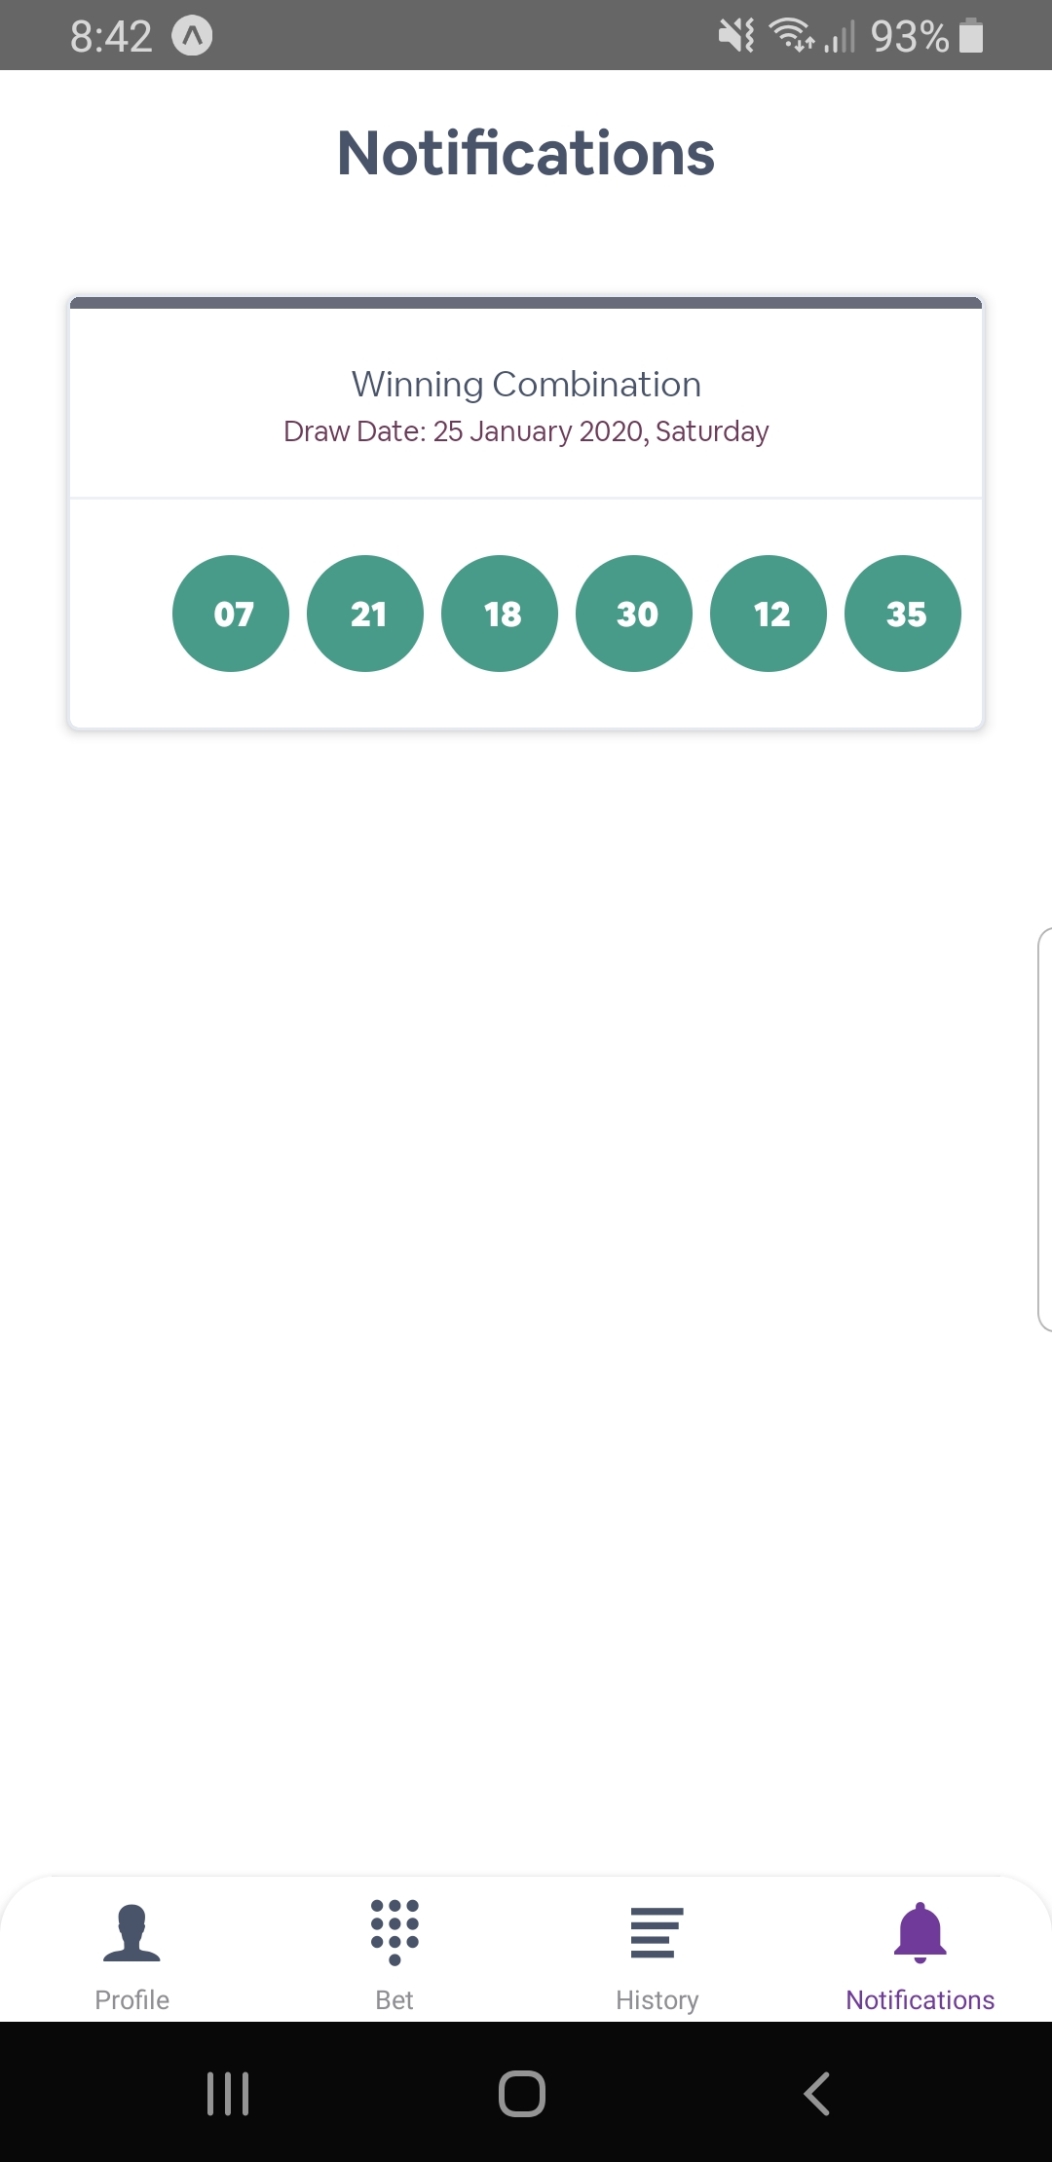
eTaya App Walkthrough:
Winning Numbers

Slide 16
Thank You

